Slide 1
Weekly Updates
Slow-Pitch Softball Detection | SDMAY25-11

Slide 2
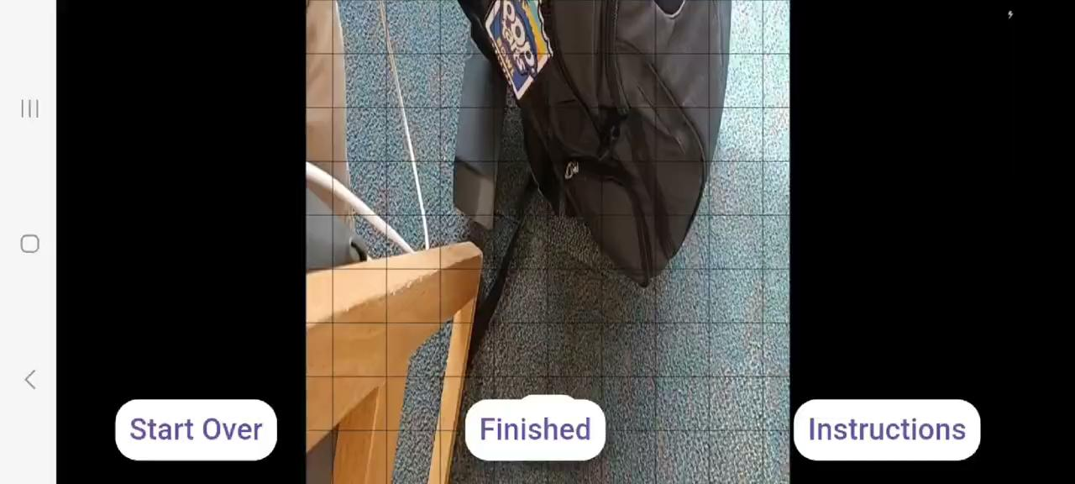
Android Orientation Work

Slide 3
Android Orientation Changes
Need to fix aspect ratio
Make sure the grid and line overlays are changed to fit new orientation changes
Need to ensure optimality and make sure it works with IOS as well

Slide 4
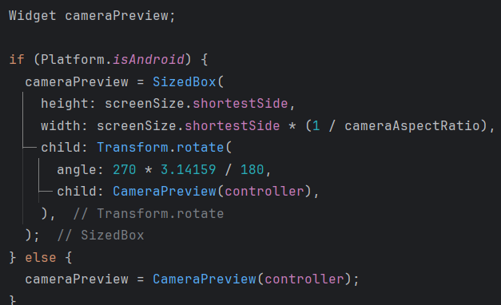
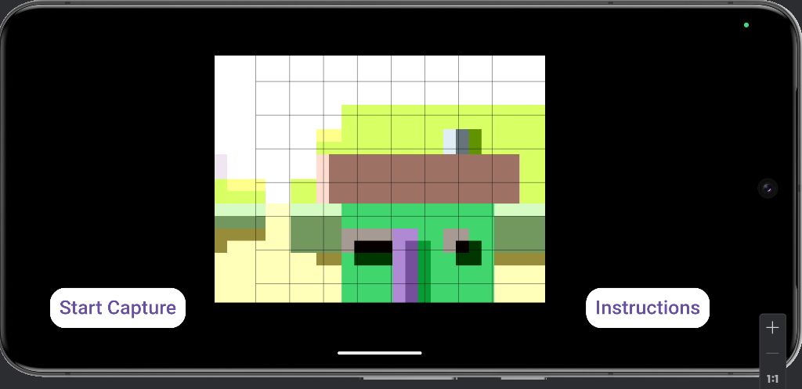
Android Orientation
Camera Controller’s takePicture() Camera Preview Rotation
Created new extended class:
RotatedCameraController
Rotates each picture when
capturing an image.
imageStream issues

Slide 5
Custom Yolo Model
Trained on Roboflow dataset from Ethan
Uses yolov8n model for Ultralytics/Flutter compatibility
Much less laggy than previous implementations

Slide 6
Questions?
GitHub
Google Drive

